Slide 1
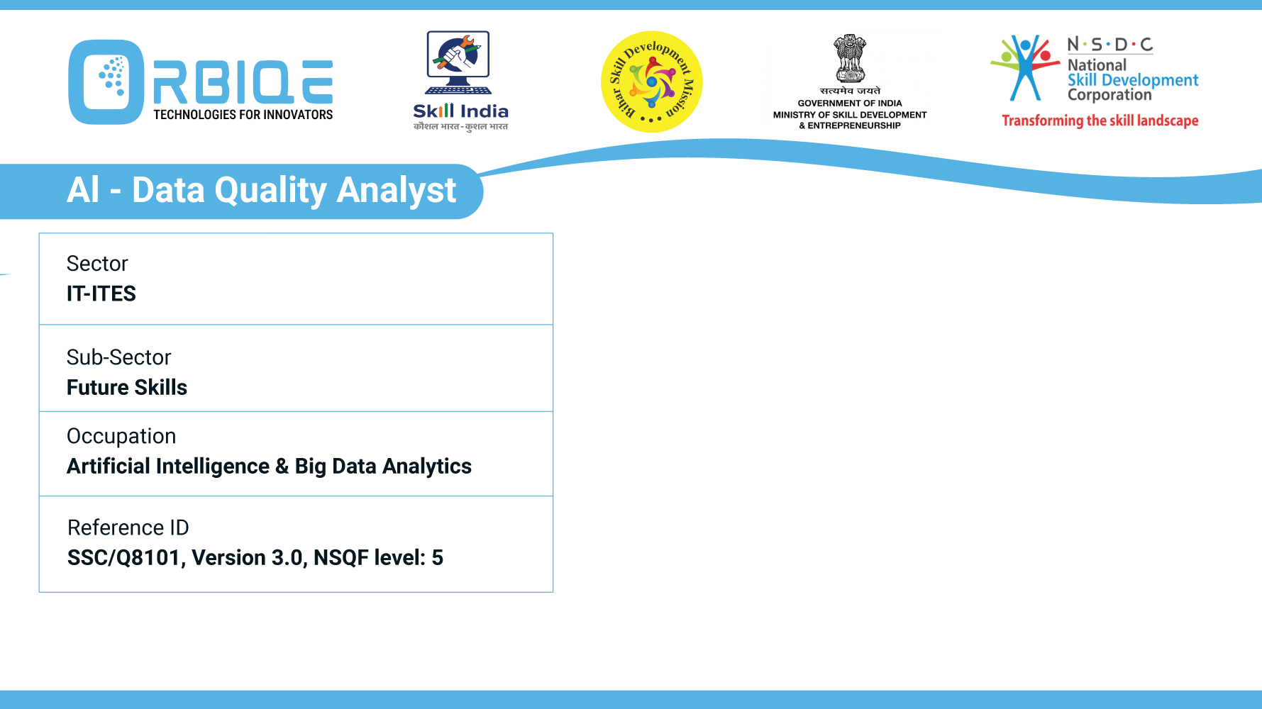
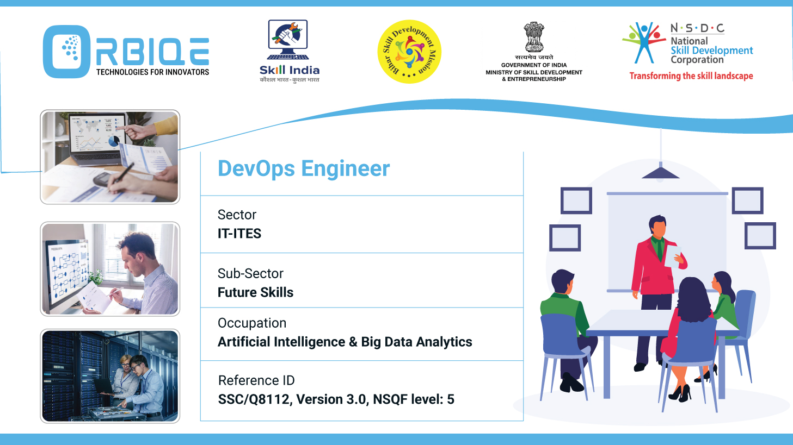
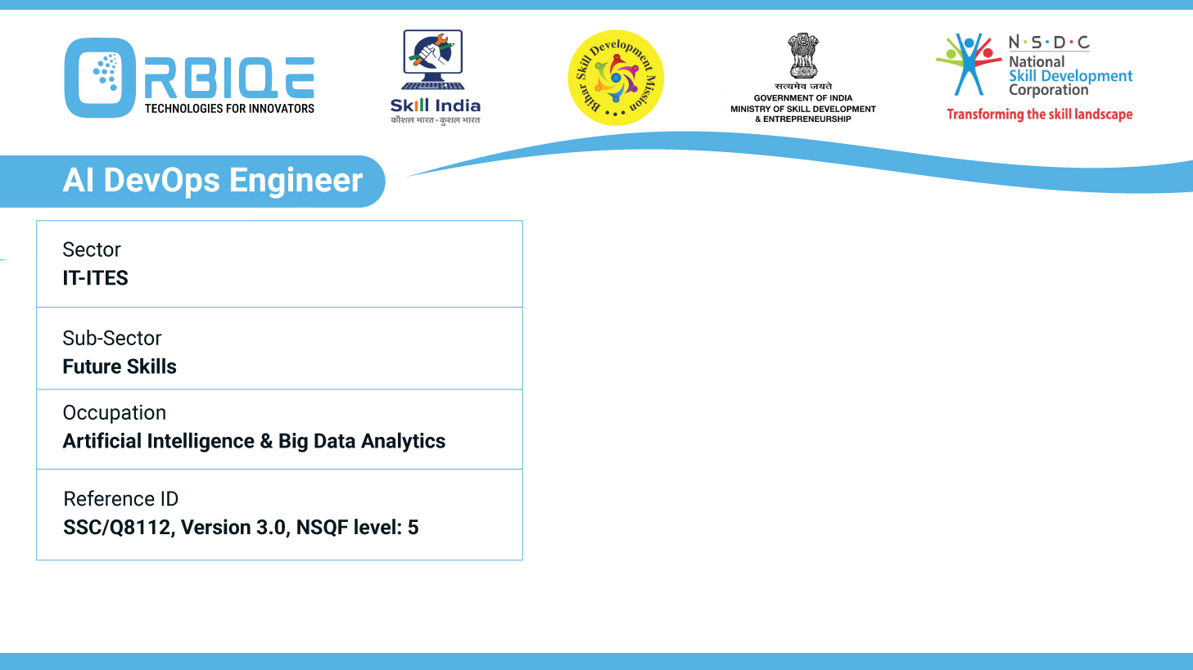
Name- Krishna Kant Dubey

Slide 2

Tools for Pre-processing data

Slide 3
Agenda
Explain the Data Normalization techniques and concepts
Describe the properties of different tools that can be used to validate the pre-processed data

Slide 4
Database Normalization
Purpose:
Eliminate data redundancy
Ensure data integrity
Prevent anomalies during insert, update, and delete operations
Key Concepts:
Normal Forms: Structured stages of normalization (1NF, 2NF, 3NF, BCNF, etc.)
Functional Dependency: Ensures that one attribute uniquely determines another
Referential Integrity: Maintains consistency across related tables

Slide 5

Database Normalization
Before normalization:
After normalization:
Separate into Customer ,Order , and Product tables
Use foreign keys to link them
Benefits:
Reduces storage requirements
Avoids update and deletion anomalies
Improves query reliability

Slide 6
Data Normalization in Analytics & Machine Learning
Purpose:
Standardize feature scales
Improve model convergence and accuracy
Prevent bias from dominant features

Slide 7
Data Normalization in Analytics & Machine Learning
Technique | Description | Use Case
Min-Max Scaling | Scales values to a fixed range (e.g., 0–1) | Neural networks, image data
Z-score Standardization | Centers data around mean with unit variance | Linear models, clustering
Log Transformation | Reduces skewness and compresses large values | Income, population, exponential data
Decimal Scaling | Moves decimal point based on max value | Simple numeric normalization
Robust Scaling | Uses median and IQR to reduce outlier impact | Data with heavy outliers

Slide 8
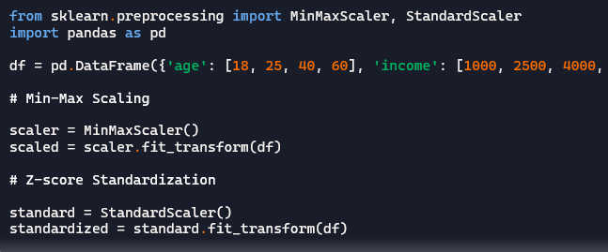
Data Normalization in Analytics & Machine Learning

Slide 9
Data Normalization in Analytics & Machine Learning
Benefits:
Ensures fair contribution of features
Improves model performance
Enables faster convergence in gradient-based algorithms

Slide 10
Thank You

